Slide 1
Establishing a Just, Learning Culture
Understanding the Learning Curve
Erik Hernandez
Professor Sue Sampson
CSD 380 DevOps
07/12/2024

Slide 2
Introduction
Definition:
A just culture is a workplace culture where people are held responsible in a fair way. It makes a clear difference between honest mistakes, risky actions, and reckless actions.
Principles:
Employees can report mistakes without being afraid of punishment.
The main goal is to learn from mistakes and improve.
People are held accountable in a fair and consistent way.
Importance:
Safety: It makes the workplace safer.
Trust: It builds trust and openness among employees.
It helps the organization keep getting better and come up with new ideas.

Slide 3
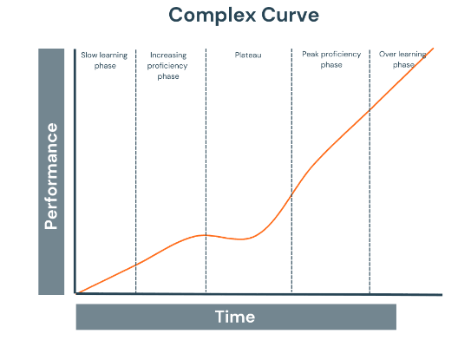
The Learning Curve
Stages of Implementing a Just Culture:
Start by teaching employees about the ideas and benefits of a just culture.
Create clear rules that explain what behaviors are acceptable and what are not.
Provide regular training to remind everyone about just culture practices.
Help employees change their attitudes and actions to align with just culture principles.
Keep checking how well the culture is working and make improvements based on feedback.
https://whatfix.com/blog/learning-curve/

Slide 4
Awareness and Education
Initial Steps:
Launching campaigns to inform employees about just culture.
Conducting sessions to explain the benefits and principles.
Using newsletters, emails, and meetings to spread awareness.
Key Educational Strategies:
Engaging employees through role-playing and scenario-based training.
Involving leaders to champion the just culture initiatives.
Providing access to materials such as handbooks, articles, and videos on just culture.

Slide 5
Policy Development and Training
Developing Policies:
Defining what constitutes human error, at-risk behavior, and reckless behavior.
Ensuring policies are consistently applied across the organization.
Involving employees in the policy development process to ensure buy-in.
Communicating Policies:
Keeping employees informed about any changes to policies.
Making policies easily accessible to all employees.
Continuous Training Programs:
Regularly scheduled training sessions to reinforce just culture principles.
Using real-life scenarios to teach employees how to apply just culture practices.
Incorporating feedback from employees to improve training programs.

Slide 6
Behavioral Change
Encouraging a Shift in Mindset:
Leaders demonstrating just culture behaviors.
Recognizing and rewarding employees who adhere to just culture principles.
Encouraging open and honest communication about mistakes and learning opportunities.
Examples of Behavioral Changes:
More frequent reporting of errors and near-misses.
Employees openly discussing mistakes without fear of punishment.
Employees actively participating in safety and improvement initiatives.

Slide 7
Measurement and Feedback
Importance of Measuring Progress:
Using surveys, audits, and performance metrics to gauge the effectiveness of just culture initiatives.
Conducting regular reviews to assess progress and identify areas for improvement.
Methods for Collecting Feedback:
Surveys and Questionnaires: Gathering anonymous feedback from employees.
Focus Groups: Conducting focus groups to get in-depth insights.
Incident Reporting Data: Analyzing data from incident reports to identify trends and areas for improvement.

Slide 8
Challenges and Solutions
Common Challenges:
Resistance to Change: Employees and management may resist changes to established practices.
Consistent Enforcement: Ensuring policies are applied uniformly across the organization.
Balancing Accountability and Learning: Finding the right balance between holding individuals accountable and fostering a learning environment.
Best Practices to Overcome Challenges:
Leadership Commitment: Strong commitment from leadership to model and support just culture behaviors.
Open Communication: Encouraging open and honest communication without fear of retribution.
Continuous Improvement: Regularly reviewing and refining policies and practices based on feedback and outcomes.

Slide 9
Case Studies
Healthcare Industry
Implementation Example:
Johns Hopkins Hospital: In 2001, a child died due to a medication mistake. After this, Johns Hopkins started a just culture. They encouraged staff to report mistakes and near-misses without fear of punishment, focusing on fixing system problems instead of blaming individuals.
Outcome:
Significant Improvement: This change led to more errors being reported, which helped the hospital find and fix system issues. As a result, patient safety improved, and there were fewer preventable medical errors. The overall safety culture of the hospital became more open and transparent.

Slide 10
Conclusion
Summary of Key Points:
Importance: Just culture promotes trust, learning, and accountability.
Learning Curve: Stages include awareness, policy development, training, behavioral change, and feedback.
Overcoming resistance, ensuring consistent enforcement, and balancing accountability and learning.
Final Thoughts:
Importance: Establishing a just culture is essential for safety and continuous improvement.
Commitment: Requires commitment, education, and ongoing assessment.
Future Steps: Encouraging organizations to take proactive steps towards building a just culture.

Slide 11
Implementing Just Culture in Healthcare." Journal of Patient Safety. National Center for Biotechnology Information, https://www.ncbi.nlm.nih.gov/pmc/articles/PMC10186448/
Just Culture: Balancing Safety and Accountability." Aviation Safety Magazine. Ethernet Digital Library, http://ndl.ethernet.edu.et/bitstream/123456789/20186/1/118.%20Sidney%20Dekker.pdf
Kim, G., Humble, J., Debois, P., Willis, J. (2021). The DevOps Handbook (2nd Edition). IT Revolution.

